Slide 1
19TH Century Gothic era
By Victoria, Lance, Sabah, Diya

Slide 2
Contents
19th Century America
British English
American English
The Masque of the Red Death

Slide 3
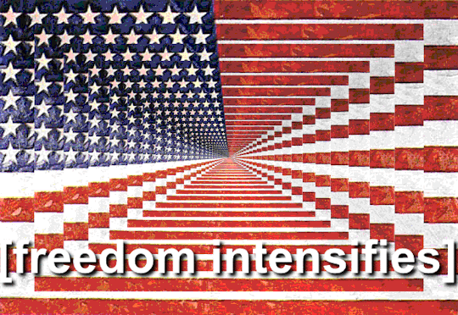
Context: America
American Dream was a core belief, developed by the Founding Fathers
1765-1820: First wave of Gothic Novel
Industrial Revolution 1790 Samuel Slater opened the 1st US Industrial Mill
Stereotypical gender roles were still the societal norm and America was a Christian dominant country
Population rate rose westward 1810: over 7.2 million 1820: over 9.6 million 1840: over 17 million
1810: The Atlantic Slave Trade was over between all continents
1861-1865: Civil War
1866: KKK was founded as a social club in Texas
1868: Slavery Abolished in US
1875-1886: The Statue of Liberty: a universal symbol for freedom
1880: White Supremacy era which later led into Civil Right Movements in the late 1900s.
Figure 1. Giphy (2018)

Slide 4
INFLUENCES of gothic
In literature it is usually associated with the English Romanticism movement and all things medieval
Literature influenced the attitudes, imaginations and beliefs of writers of all genres and artists
Medievalism was a heavy influence onto the era and there were many attempts to reconstruct this ‘offering of an ideal nobility and harmony’

Slide 5
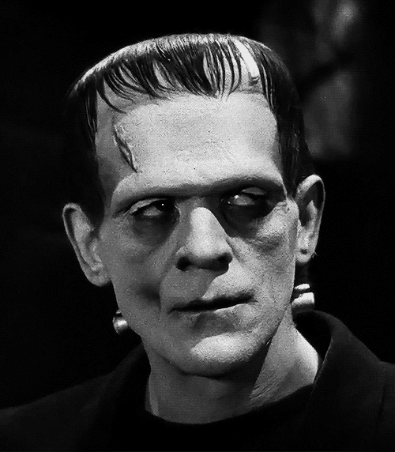
BRITISH/AMERICAN GOTHIC LITERATURE
British Gothic Literature | American Gothic Literature
Emerged because of enlightenment | Emerged from Transcendentalism which was prominent in the East
Early gothic settings were medieval castles, ruins, monasteries, | Dark Romanticism is synonymous with American Gothic
Highest peak in 1790s | Peaked at the end of the Romantic period
Movement to counteract the French Revolution | Movement to coincide with the Gothic period in Europe
Generally considered to be during 1790-1830 | Generally considered to be during 1800-1860
2 most important gothic literary works: Mary Shelly’s Frankenstein (1818) Bram Stoker’s Dracula (1897) | 2 most popular gothic literary works: Shirley Jackson’s We have always lived in the Castle (1962) Shirley Jackson’s The Haunting of Hill house (1959)
Figure 2/3. Giphy (2018)

Slide 6
General conventions of gothic
CONVENTIONS:
Shadows, flickering candles, electrical faults, strange glowing firelight
Crazed laughter
Abandoned areas
Characters being trapped
Baying of wolves and dogs
Sighs, moans, clanking, howls and eerie sounds
Footsteps
Slamming doors
Storms
MOTIFS:
Doppelgangers
Omens, curses, prophecies
Dreams, nightmares, visions
Light, darkness, shadow, warmth, cold
Psychiatric medical conditions
Forbidden knowledge or power
GOTHIC FICTION ELEMENTS:
Fear
Horror
Death
Gloom
Nature
Individuality
Very high emotion
GOTHIC TONE AND MOOD:
Highly emotional states of terror, anxiety, vengeance, obsession, dread
Mood: mysterious, suspense, terror, melancholy, foreboding

Slide 7
Brief History and development of British English 19C
1800 - 1900 Industrialization, urbanization, emergence of new technologies and scientific discoveries as well as education increased
Industrialisation refers to the development of machine production of goods and new energy resources.
New words were coined for new products, machines and processes that were developed at this time
The industrial and scientific advances created a need for neologisms which derived from Greek and Latin roots.
In the 19th century there was a rise of the progressive passive
Received Pronunciation (often associated with SE of England) became the accent associated with prestige & good education.
In the Midlands the diphthongs in words like ‘throat’ and ‘stone’ were kept apart whereas in RP they fell together

Slide 8
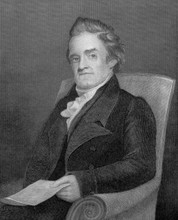
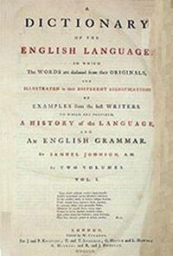
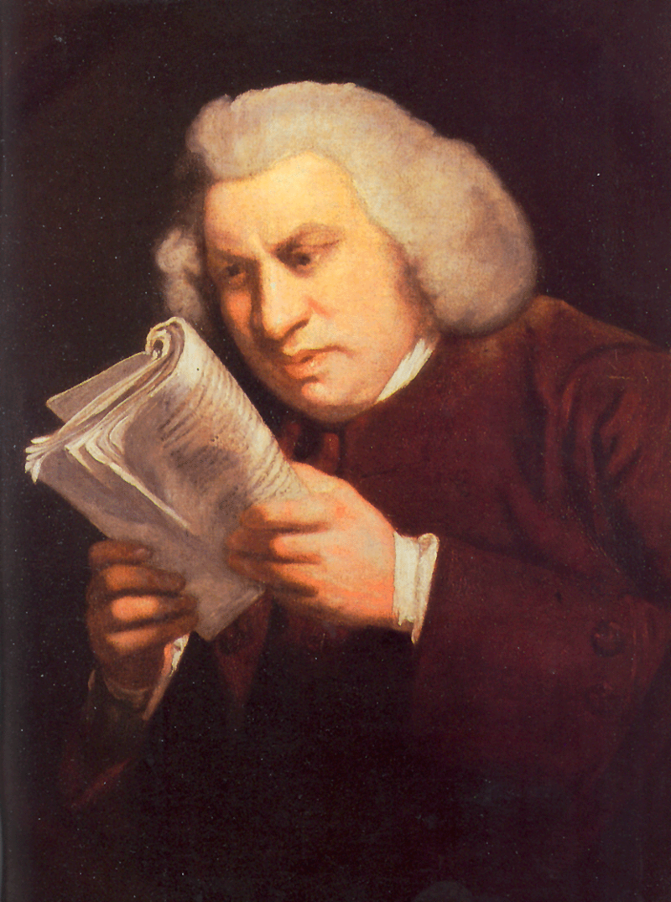
Webster & Johnson
Samuel Johnson’s (English author) dictionary, 1755 was the most comprehensive of its time and has had a great influence in the English Speaking World.
He focused on changing homographs to alternative spellings to reflect meaning.
Wasn’t interested in reform
No longer a ‘k’ in many words eg.’musick’ due to his influence.
Noah Webster (American lexicographer) is most notable for his work - The American dictionary of English language which aimed to show American English developing differently from British English. His work was held to similar esteem as Samuel Johnson’s. Webster reformed the spelling of the British Language so it had a distinct American identity and was ultimately easier to understand.
Figure 4/5/6.

Slide 9
American English
In terms of the ‘progress of English’, the first expedition that took place in the late 16th Century is what renounced English as a world language.
The first venture failed due to conflict with the Indians.
Figure 7.
Crystal,(2002): 242

Slide 10
American English
1620
First group of puritans arrived. They arrived mainly from East Anglia so accents were different. They did not pronounce the r after vowels
1790 – first census. Population was at four million. The accent that emerged is now commonly used with present day American-English
1607
First expedition arrived at Chesapeake Bay
1640
25,000 people settled in Plymouth, Massachusetts
Southern explorers predominantly came from the West Country so the accent was brought with them. They pronounced the r after the vowels. (Crystal, 2002: 241)

Slide 11
American English
The main population movements preserved the three major dialect areas of the east coast:
New England people moved West
Southerners moved along the Gulf Coast and into Texas
Midlanders spread throughout the vast mid-eastern area, across Mississippi into California
(Crystal, 2002)

Slide 12
American English
Pronunciation
Spelling
American speakers stress certain words differently to British English speakers.
American and British spellings are quite different in some aspects:
Colour
Color
Ballet | Debris | Address | Magazine
Ballet | Debris | Address | Magazine
Honour
Honor
Labour
Labor
Some words have one main stress in British English but two in American English
(Crystal, 2002: 265-266)
The –ou- is derived from British English and the –o- is derived from American English
Auditory | Secretary | Laboratory | Birmingham
Auditory | Secretary | Laboratory | Birmingham
(Crystal, 2002: 265)

Slide 13
American English
Grammar
Vocabulary
There are many small differences in the grammar of both dialects:
There are words used in both American and British English but with different meanings:
Twenty to four
Twenty of four
 | AmE | BrE
Dumb | Stupid, mute | Mute
Knock up | Get a woman pregnant | Get someone to answer
Pants | Trousers | Underpants
Pavement | Any paved surface | Pedestrian path
Half an hour
A half hour
I burnt it
I burned it

Slide 14
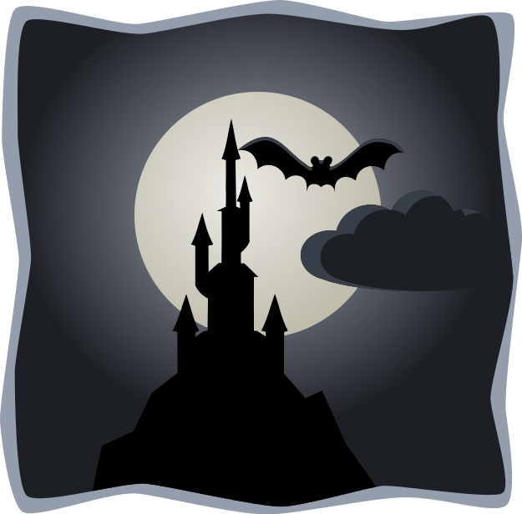

Slide 15
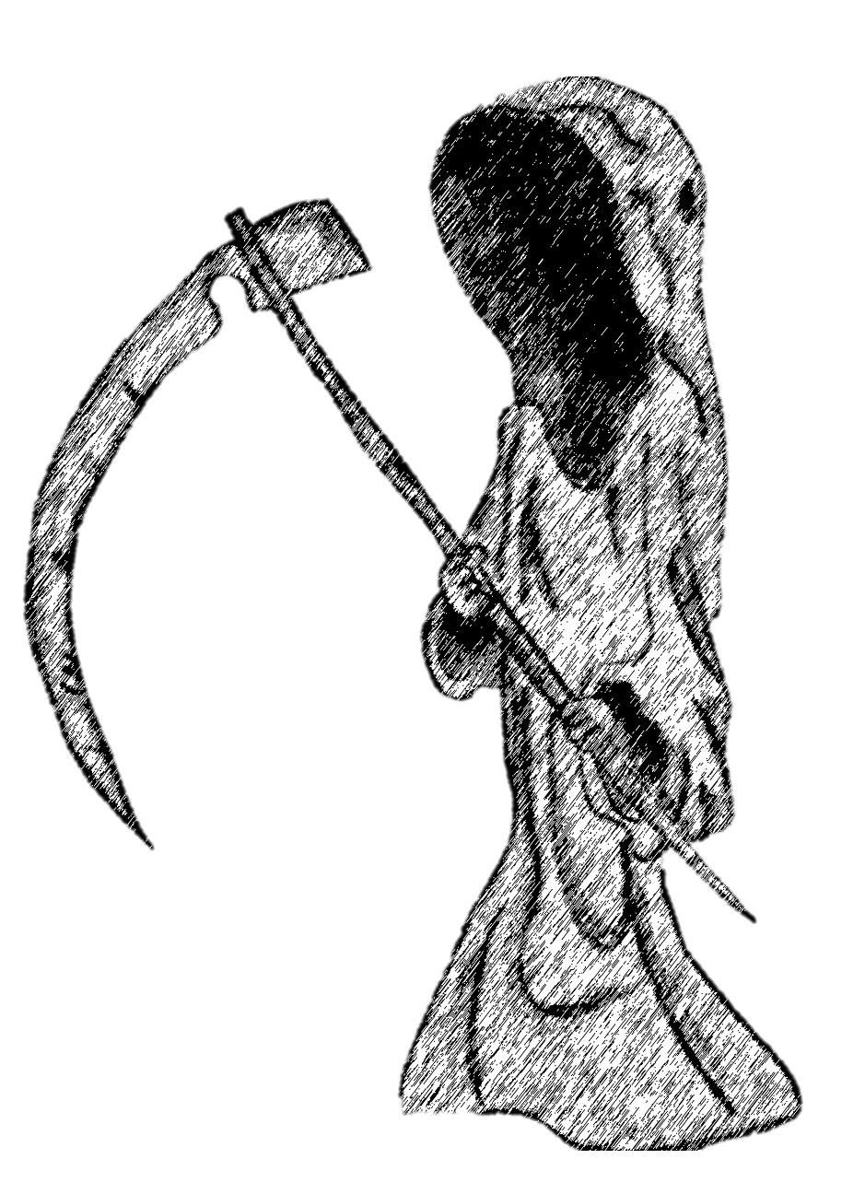
THE masque of the red death
Summary: 'The Red Death' takes over Prince Prospero's kingdom. He locks himself and his company away in the abbey to evade death.
Conventions of the gothic genre that are evident:
Terror- Poe uses terror (i.e. inexplicit descriptions) rather than horror to open the readers mind without making them distressed (Bowen 2014).
Beauty vs horror- Poe creates a sharp contrast between the beauty and pain found in death.
Human fallibility- Prince Prospero and his company believe they can avoid death.
Madness- it isn't clear whether the Prince is actually mad. This might be a commentary on the judgement of 19th Century society.
Gloomy setting- the corruption of the perfect setting highlights that not even the upper class are untouchable. American authors used settings (e.g. the abbey) that weren't apart of the American landscape, as it was believed that there wasn't enough architectural history in America to use in Gothic literature. Hence, their eyes were “trained” on the European landscape. (Crow 2009: 10)
Supernatural- the masked figure is described as ghostlike and unhuman.
Figure 8.

Slide 16
Analysis of the masque of the red death
The seven apartments- allegory for the stages of human life. Prince Prospero chases the masked figure through the seven apartments, where he finally encounters the figure in the black room. Thus, he both literally and metaphorically runs to his death.
The ebony clock- each time it chimes, the party stops. The clock serves as a reminder to the guests that they cannot avoid death and suggests that death is approaching.
The red death- the masked figures identity remains unknown and is a physical manifestation of death. The use of person deixis further elevates the mysteries surrounding death.
Figure 9.

Slide 17
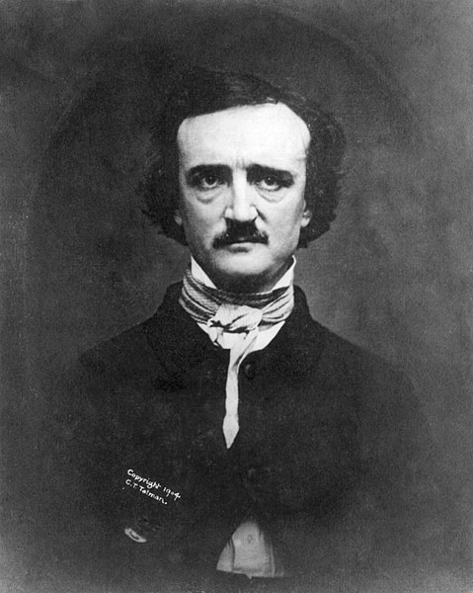
Poe and the 19th Century
The influence of Poe's life on the story
The disease may in fact be inspired by tuberculosis- coined ‘The White Death’ in the 19th Century.
Poe’s wife suffered from tuberculosis when the story was written and Poe also lost several other family members to the disease.
Prince Prospero’s attempts evade death may reflect Poe’s struggle to cope with death and loss.
The influence of the 19th Century on the Gothic genre
As technology and science advanced in the 19th Century, the mortality of man became more concerning. People were desperate to find ways to avoid death, and consequently this became a staple in Gothic literature.
Figure 10.

Slide 18
The language used in masque of the red death
With the gothic era dominating 19th Century literature, many new words relating to gothic themes entered the language. For example, Spectral, which is used to describe the masked figure.
Arguably, Poe's writing is somewhat closer to British English than American English. For example, he uses the British expression "half an hour" rather than the Americanism "a half hour".
Many American writers were under pressure to please British critics as British literature had much more history and acclaim, whilst also attempting to establish a native identity (Britannica 2018)
Poe's use of the word 'apartment' is distinctly American. The word entered the language in the 17th Century.

Slide 19
references
Britannica Inc. (2018) Varieties of English- British English [online] available from< https://www.britannica.com/topic/English-language/Varieties-of-English > [5 November 2018]
Britannica, Inc. (2018) American Literature – The 19th Century [online] available from <https://www.britannica.com/art/American-literature/The-19th-century> [10 November 2018]
Crow, C.(2009) American Gothic. Cardiff: University of Wales Press
Crystal, D.(2002) The English Language. 2nd Edition. London: Penguin Books
Purple Planet Music (n.d.) Purple Planet Music [online] available from <https://www.purple-planet.com/creepy> [21 November 2018]
The British Library (n. d.) Gothic Motifs [online] available from <https://www.bl.uk/romantics-and-victorians/articles/gothic-motifs> [31 October 2018]
The Centre for the Study of Christianity and Culture, University of York (1999) Crossref-it.info [online] <https://crossref-it.info/articles/91/gothic-and-the-medieval-revival>; [2 November 2018]
The English Spelling Society (2018). A brief history of English spelling [online] available from <http://spellingsociety.org/history#/page/9> [5 November 2018]
Oxford University Press. (2018) Nineteen Century English- an overview [online] available from https://public.oed.com/blog/nineteenth-century-english-an-overview/ [3 November 2018]

Slide 20
List of figures
Giphy Inc. (2018) Giphy [online] available from<https://giphy.com/search/royalty-free-romantic-era> [21 November 2018]

